Slide 1
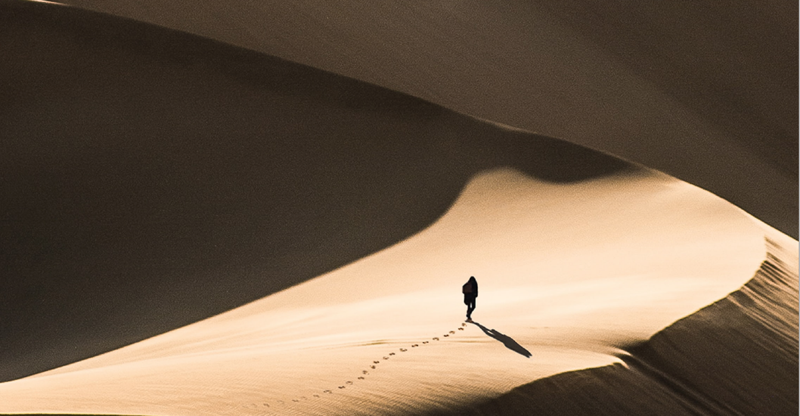
Environmental Footprint
An introduction to the initiative of the European Commission
December 2021
Swedish Life Cycle Center report no 2022:4
The material was produced within the project Environmental Footprint in Sweden – increased competence and communication. A project managed within the Swedish Life Cycle Center and with funding from Vinnova, Sweden’s innovation agency.
Notes:
The European Commission Environmental footprint process
The presentation aims to introduce the European Commission initiative Environmental Footprint.
The material was produced within the project Environmental Footprint in Sweden – increased competence and communication. A project managed within the Swedish Life Cycle Center and with funding from Vinnova, Sweden’s innovation agency.
Published: December 2021
Authors: Sara Palander, Swedish Life Cycle Center; Björn Spak, Swedish Environmental Protection Agency; Karin Sanne, IVL; Katarina Lorentzon, RISE; Torun Hammar

Slide 2
Content
Introduction
Aim of the Environmental Footprint?
Background
How it might look
What’s in it for me?
What is Environmental Footprint?
Life Cycle Assessment (LCA)
PEF & OEF
Category Rules & Sector Rules
Standards for PEF & EPD
PEF vs EPD
PEF & EPD
Product Environmental Footprint in policy
Possible uses of the methods in policy
PEF in Sweden
What has Environmental Footprint resulted in?
More information
Contact
Notes:
This is the content of the presentation.
The presentation can be used as a whole or in sections, depending on occasion and what kind of information is needed.

Slide 3
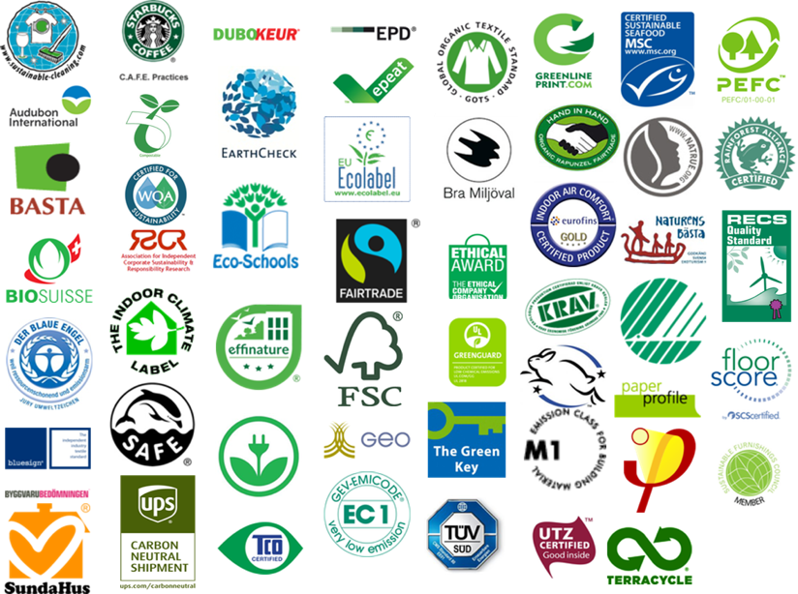
Introduction
The requirements and expectations for communicating environmental performance of products and services are increasing
Notes:
In recent years, the interest has increased in communicating the environmental performance of products, services and organizations. The external requirements are also increasing from the market, from investors, customers and consumers, and there are also legislative and policy requirements. And there are internal interest from companies that want to change and take the lead.
Among other things, this has led to a prolipheration of environmental labels and systems on the market that make it complex to understand, or even misleading or false, and costly to comply with for both companies and consumers.
Part of the European Commission's initiative "Single Market for Green Products", aims to facilitate better information on the environmental performance of products and organizations.
It says that there is a need to create a common methodology for assessing and comparing environmental performance based on comprehensive environmental impact assessment in a life cycle perspective (environmental footprint).
This is the “reason to be” of environmental footprint methods Product Environmental Footprint (PEF) and Organisation Environmental Footprint (OEF).
http://ec.europa.eu/environment/eussd/smgp/policy_footprint.htm

Slide 4
Aim of the Environmental Footprint
“
To improve the environmental performance of products, services and organisations in the European market through a combination of market pressure and policy instruments, using information that is
reliable
comparable
verifiable”
Notes:
On December 16, 2021, The European Commission adopted a revised Recommendation on the use of Environmental Footprint methods helping companies to calculate their environmental performance based on reliable, verifiable and comparable information, and for other actors, such as public administrations, NGOs and businesses to have access to such information. It will incentivise industry to manufacture products that have a better environmental performance, helping the EU's European Green Deal and circular economy ambitions.
The overall aim is to overcome unsustainable consumption and production systems and the Environmental Footprint will contribute to improve the environmental performance of products, services and organisations in the European market through a combination of market pressure and policy instruments, using reliable, verifiable and comparable information
And this will provide robust and sufficient methods also for policy development
Additional information:
PEF and OEF are
•Reproducible: methodological choices taken in method/ product-and sector-specific rules (PEFCRs/ OEFSRs) –this also leads to simplification
•Comparable: when PEFCRs exist, specific products’ performance is comparable to a benchmark (average environmental performance)
•Reliable: best practice methodological solutions discussed with experts and stakeholders. Minimum verification requirements included in the method
•Agreed: methodological choices taken based on input from experts (business, academia, public administrations, NGOs)
•Less costly: businesses apply one, not many, methods. Where secondary impact data is to be used, this is available for free to PEFCR/ OEFSR users

Slide 5
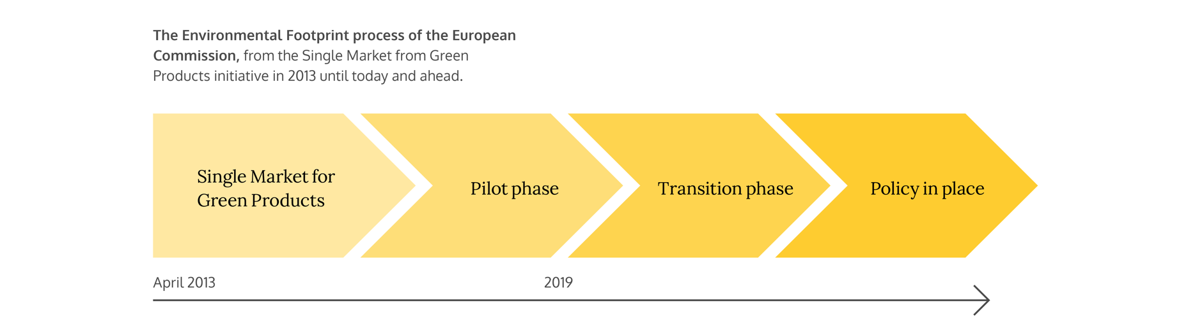
Background
Notes:
On this page you will see the journey from the launch of the Single Market for Green Products initative in 2013, when the methods were introduced and launched.
And from 2013 until 2018 these methods were tested in a pilot phase aimed to
1. test the process for developing product- and sector-specific rules (PEFCR and OEFCR);
2. test different approaches for verification;
3. test communication vehicles for communicating life cycle environmental performance to business partners, consumers and other company stakeholders.
In the pilot phase more than 250 leading stakeholders were involved and more than 2000 stakeholders followed the process.
In 2019 the pilot phase turned into a transition phase, which is still ongoing (December 2021),
The aim of this phase is to
1. develop policy suggestions based on PEF and OEF
2. monitor implementation/analysis of market uptake
3. develop more product- and sector-specific rules
4. method improvements
In the last phase, we will see policy in place, where the methods or parts of the methods will be used in policy and legislation.
The European Commission says that the methods are to be further developed and improved

Slide 6
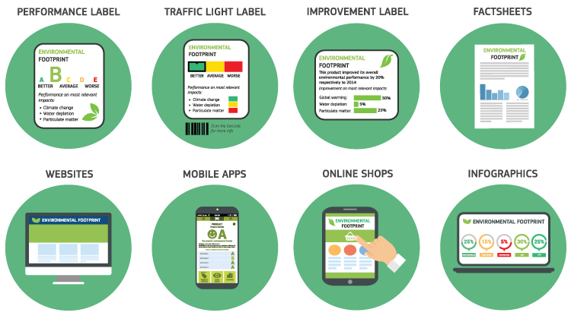
How it might look
Source: PEF end conference 23-25 april 2018
Notes:
What it is not:
Communication aspects are not part of the PEF method – it does not prescribe any specific approach or label.
This picture was shown at an Environmental Footprint conference, arranged by the Commission, in April 2018.
It might look like this in the future!

Slide 7
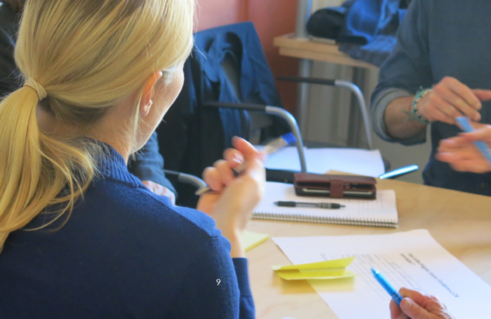
What’s in it for me?
Optimisation of process along the life cycle of a product
Avoiding trade offs
Identification of environmental hotspots
Minimise environmental impacts along the life cycle
Environmental performance improvement and tracking
Responding to increasing external pressure
Co-operation along supply chains
Marketing
Participating in 3rd party schemes related to environmental claims
Notes:
The life cycle approach of Product Environmental Footprint (PEF) gives the possibilities for:
Optimisation of process along the life cycle of a product,
Avoiding trade offs between different value chain steps and between different environmental impacts (life cycle approach)
Identification of environmental hotspots, makes it possible to set in actions where it is most efficient.
Minimise environmental impacts along the life cycle
Environmental performance improvement and tracking - to make real improvement
Responding to increasing external pressure, from customers and consumers
Co-operation along supply chains to optimise the product life cycle,
And you can use these specific methods for Marketing purposes,
Participating in 3rd party schemes related to environmental claims

Slide 8
What is Environmental Footprint
Product Environmental Footprint (PEF)
Organisation Environmental Footprint (OEF)
Methods for measuring and communicating the life cycle environmental performance of products and organisations of the European Commission.
Notes:
What is Environmental footprint (In Swedish Miljöavtryck)?
It is two methods, Product Environmental Footprint (PEF) and Organisation Environmental Footprint (OEF)
Which are methods for measuring and communicating the life cycle environmental performance of products and organisations of the European Commission.
The methods are built on existing systems for environmental communication and international standards, but with more specific requirements.
When PEFCRs exist, specific products’ performance is comparable to a hypothetic but realistic benchmark product, with the average environmental performance of that product category.

Slide 9
Life Cycle Assessment (LCA)
Notes:
The Environmental footprints build on Life Cycle Assessment
What is Life Cycle Assessment or LCA (in Swedish Livscykelanalys)?
Life Cycle Assessment describes and quantifies products’ and services’ impact on the environment and society throughout the entire life cycle, from raw material extraction to the end-of-life management, via production, distribution and use.

Slide 10
PEF & OEF
“
Calculates the environmental performance and takes into consideration the environmental impacts throughout the entire value chain, from the extraction/growing of resources to the end of life of the product (PEF) or the product portfolio of an organisation (OEF)”.
Notes:
The Environmental Footprint methods, Product Environmental Footprint (PEF) and Organisation Environmental Footprint (OEF), were developed to put the same environmental requirements and rules for the whole European market. These methods are based on Life Cycle Assessment and the ISO standards 14040:2006* and 14044:2006**.
PEF and OEF calculates the environmental performance and takes into consideration the environmental impacts throughout the entire value chain, from the extraction/growing of resources to the end of life of the product (PEF) or the product portfolio of an organisation (OEF).
The methods cover 16 environmental impacts, including climate change, and impacts related to water, air, resources, land use and toxicity, and give a comparison of environmental performances between similar products and companies active in similar sectors.

Slide 11
Category Rules & Sector Rules
To carry out a PEF and OEF compliant study, product category and sector guidelines have been or are being developed
Recipe on how to perform a
  PEFCR – Product Environmental Footprint Category Rules
  OEFSR – Organisation Environmental Footprint Sector Rules
PEFCR - Rules to calculate the relevant environmental information of the organisations belonging to the sector in scope.
OEFSR - Rules to calculate the relevant environmental information of products belonging to the product category in scope.
Notes:
To carry out a PEF and OEF compliant study, product category and sector guidelines have been or are being developed
These rules include guideline for development of PEF for a product category or OEF for a sector.
It is like a recipe on how to perform a
PEFCR – Product Environmental Footprint Category Rules
OEFSR – Organisation Environmental Footprint Sector Rules
For a PEFCR the recipe describes rules to calculate the relevant environmental information of products belonging to the product category in scope.
For a OEFSR the recipe describes rules to calculate the relevant environmental information of the organisations belonging to the sector in scope.

Slide 12
Rules include
PEFCR and OEFSR include
  Scope (system boundaries, functional unit etc)
  Relevant environmental impact categories
  Most important impact life cycle stages
  Possible data sources
The structure and granularity of PEFCR follows the Classification of Products by Activity (CPA) system
Notes:
These rules includes guideline for a specific product category on how to
- Defining the goal and scope of the study
- Relevant impact categories
- System boundaries
- Identifying hot-spots - key parameters and life-cycle stages and the most important impact categories
- Possible data sources
The structure and granularity of PEFCR follows the Classification of Products by Activity (CPA) system

Slide 13
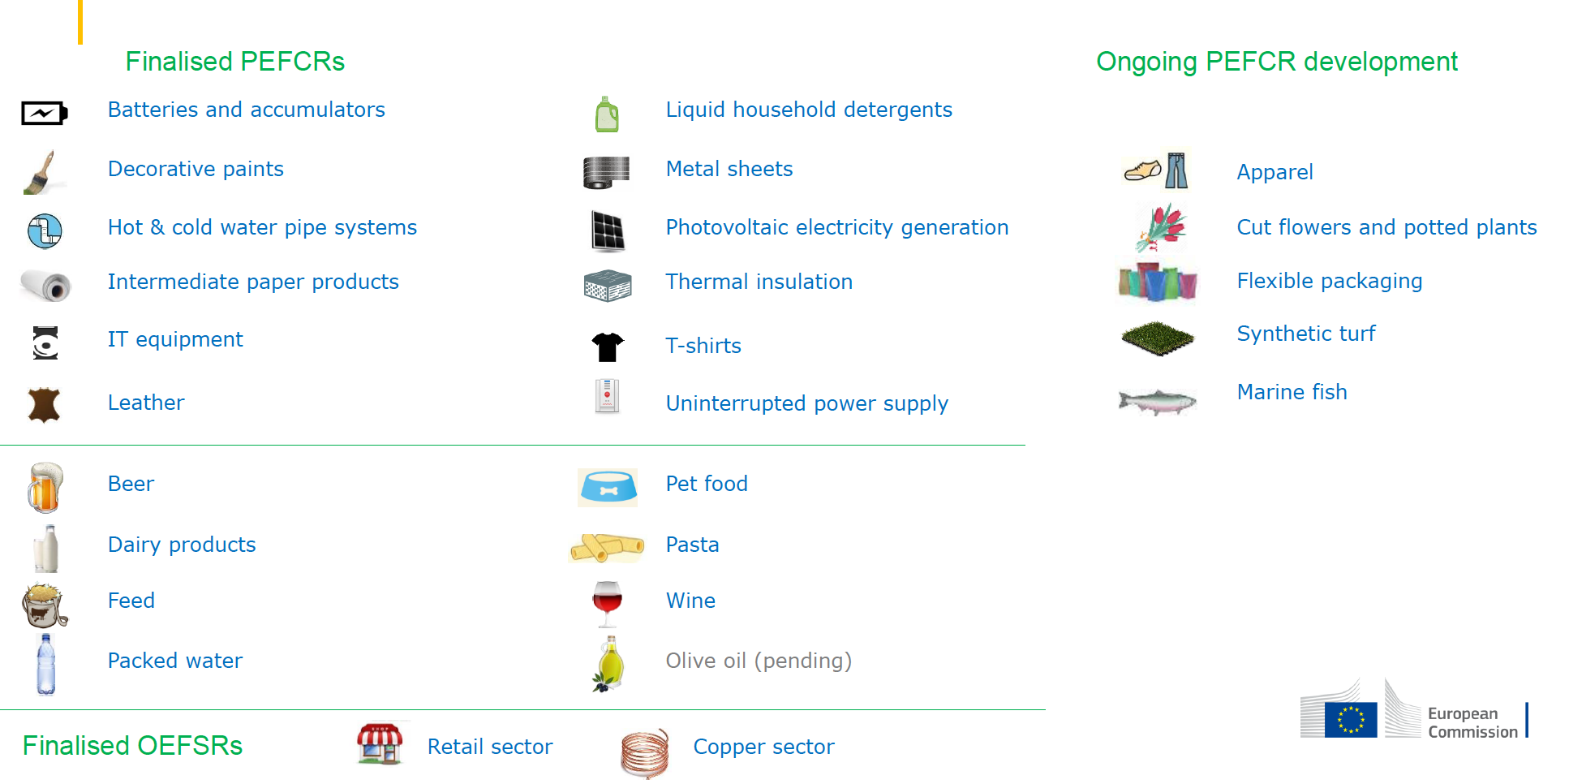
PEFCRs & OEFSRs
Notes:
In this slide you will see finalised PEFCRs and OEFSRs and also ongoing PEFCR development.
December 2021.

Slide 14
Standards for EPD & PEF
Environmental Product Declaration
Product Environmental Footprint
Complementary (c) - PCR
Product Caregory Rules
EN 15804 / ISO 21930
General Programme Instructions
ISO 14025
ISO 14040 / ISO 14044
ISO 9001 / ISO 14001
ISO standards
(14040, 14044, 14025)
ILCD Handbook
Environmental Footprint guide
PEFCR / OEFSR
(Tools,
Data-
base)
Notes:
Many companies and actors are familiar with Environmental Product Declaration, often known as its abbreviation EPD.
Environmental Product Declarations (EPD) is an independently verified and registered declaration that communicates transparent and comparable information about the life cycle environmental impact of products and services. EPDs are based on LCA but are not part of the Environmental Footprint framework by the European Commission. There are a great number of similarities between the two frameworks but also some differences. EPDs are also based on ISO 14040 and 14044 and furthermore on ISO 14025, so called type III environmental declaration. EPDs are used voluntarily in many sectors and are especially frequent in the building sector where the additional standard EN 15804 is used.
EPD and PEF are based on the same Life Cycle Assessment standards.
EPD is following ISO 14025, General Program Instructions (GPI) and Product Category Rule (PCR) but PEF follows ILCD Handbook (International Reference Life Cycle Data System Handbook), Environmental Footprint Guide and PEFCR

Slide 15
PEF vs EPD
 | PEF - Product Environmental Footprint | EPD - Environmental Product Declaration
History | Initiated ~2013 Now in transition phase | Start ~1998 Now fully operational and globally recognised
Application | Primarily: Policy making Other uses are being discussed | Primarily: Business-to-business communication but also e.g. public procurement, ecodesign
Independently verified | Yes | Yes
Rules | PEF guide, PEFCRs | ISO 14025, EN 15804, GPI, PCRs
Generic datasets | Specific datasets, to be used only for PEF | Any data that fulfils the data quality rules
Benchmarking | Yes, ranking is part of the PEF | No, ranking is not part of the EPD
Notes:
In this picture you will find some basics about the two frameworks.

Slide 16
PEF & EPD
Three Similarities
Three differences
Purpose
Comparability
Product perspective and several product groups
Underlying framework
Communication format
Technical details in methods
=
≠
Notes:
There are many similarities between PEF and EPD frameworks and the three major ones are:
The purpose
improve the environmental performance of products and services.
Communication of environmental performance
Comparability – based on specific rules, different results for a specific category can be compared, but a benchmark is only available for a specific product category in Environmental Footprint
Both frameworks has a product perspective and several product groups are included and specific product category rules are developed
But there are also some differences, for example:
The underlying framework are different. PEF studies relies on the ”EUROPEAN COMMISSION RECOMMENDATION of 16.12.2021 on the use of the Environmental Footprint methods to measure and communicate the life cycle environmental performance of products and organisations” and respective PEFCR. There are about 50 different EPD systems, all referring to ISO 14025 (ISO= The International Organization for Standardization) and some also to ISO 21930 (International standard for building products) or EN 15804 (European standard for building products. In addition to the standards the Programme Operators of the EPD schemes publish General Program Instructions (GPI) (or similar) as well as Product Category Rules.
The communication format with different mandatory information, PEF has a benchmark that is available for each specific product category
The technical details in the methods are not the same in all aspects, but are overlapping a lot. Notable diffrences may be in selected impact categories, system boundaries and allocations regarding e.g. end of life.

Slide 17
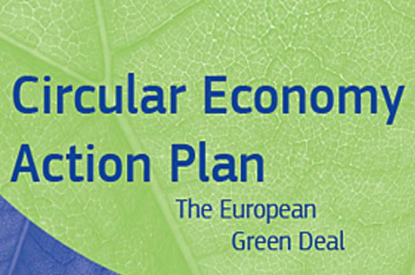
Product Environmental Footprint in policy
Circular economy action plan
For design of sustainable products, the Ecodesign Directive will be widened beyond energy related products, building as appropriate on the Product Environmental Footprint approach.
“The Commission will propose that companies substantiate their environmental claims using Product and Organisation Environmental Footprint methods.”
Legislative proposal will be presented by the EC in late Q1, 2022.
Notes:
Circular economy action plan
The Circular Economy Action plan mentions the use of EF for two different purposes – design of sustainable products and substantiation of green claims.
Both purposes are indicated by the aim of the PEF “Improve the environmental performance of products and services in the European market through a combination of market pressure and policy instruments”
Design of sustainable products is addressed through the Sustainable Products Initiative (SPI) launched by the EC in September 2020 with a legislative proposal anticipated by late Q1 2022. The back-bone of the SPI is the widening of the Ecodesign Directive to cover other products than energy related. The review of the Ecodesign criteria will build, where appropriate, on previously established EU methods and criteria e.g. the Product Environmental Footprint approach.
Substantiating of claims relating to the sixteen environmental impact categories of the EF, and the overall claim of “environmental preferability” is addressed through the Green Claims Initiative launched in July 2020 with a legislative proposal anticipated by late Q1 2022. The Commission will propose that companies substantiate their environmental claims using Product and Organisation Environmental Footprint methods.”
The Commission will test the integration of these methods in the EU Ecolabel and include more systematically durability, recyclability and recycled content in the EU Ecolabel criteria.
(Claims not relating to the sixteen impact categories of the EF (or “environmental preferability”), e.g. recycled content, is handled by another initiative (Consumer law) by DG JUST
Besides the Sustainable Products Initiative and the Green Claims initiative – parts of the EF method, and relevant PEFCRs, are referred to in:
Proposed battery regulation.
Proposed Ecodesign requirements (under the current Ecodesign Directive) for photovoltaic solar panels.
EU Taxonomy

Slide 18
Possible uses of the methods in policy
Battery regulation
Taxonomy regulation
EU Ecolabel
Sustainable Products Initiative
Green Claims Initiative
Current Ecodesign Directive
Notes:
Uses of the EF methods -examples
Definition of thresholds for classes of performance for products
•E.g. carbon footprint thresholds by Batteries Regulation proposal and solar photovoltaic panels under the current Ecodesign Directive
•E.g. environmental thresholds through widening of Ecodesign Directive (Sustainable Products Initiative)
Tracking environmental performance
•E.g.the delegated act on climate mitigation under the Taxonomy regulation
Hotspot identification along the value chain, steering innovation
•E.g. use in EU Ecolabel to identify hotspots (background to criteria definition)
Communication of environmental profile and labelling/ reporting
•E.g. options under the Green claims initiative
•E.g. mandatory carbon footprint declaration by Batteries Regulation proposal
Considering how the battery regulation and current Ecodesign directive refers to the EF method, this might very well happen within other areas as well – especially when there is a PEFCR published!

Slide 19



PEF in Sweden
The Swedish Environmental Protection Agency
Notes:
By order of the Swedish government, the Swedish EPA carries out the official representation of Sweden in the European Commission (EC) development of Environmental footprints: Integrated Product Policy/Sustainavble Consumption and Production (IPP/SCP), EF-subgroup and Technical Advisory Board (TAB).
The Swedish EPA will be part of the Swedish representation in negotiations of legislative proposals made by the EC integrating EF-related requirements (e.g. Sustainable Products Initiative (SPI) and green claims)
The Swedish EPA is also part of a nordic co-operation through Nordic Council of Ministers and the Nordic Environmental Footprint group – to impact the EU COM
Swedish Life Cycle Center
A national competence centre with a long history of working for its vision credible and applied life cycle thinking globally.
The Swedish Life Cycle centre hosts an Environmental Footprint expert group consisting of partners representing:
Universities
Industries
Research Institutes
Government agencies
Industry assossiations
Swedish Life Cycle Center co-ordinates the input of Swedish representatives to the TAB, involving also stakeholders not represented in the TAB.
The collaboration on EF within the Swedish Life Cycle Center gives a very strong Swedish position in understanding and influencing Environmental Footprint development and implementation through strengthening partners and other stakeholders, through direct input via EU Environmental Footprint Technical Advsory Board (TAB) and through the official channels of the Swedish EPA.

Slide 20
What has Environmental Footprint resulted in?
Increased knowledge and understanding about products from a life cycle perspective
Increased harmonisation on methodology issues
Increased and new collaboration within and between sectors and with other stakeholder groups
Increased knowledge about and focus on the life cycle perspective
Increased life cycle-based information and increased transparency
Notes:
So far, the road has been long and anything but straightforward, but a deeper understanding of the life cycle perspective and especially LCA methodology has been built up and new collaborations have been created.
The process has so far resulted in:
Increased knowledge and understanding about products from a life cycle perspective
Increased harmonisation on methodology issues
Increased and new collaboration within and between sectors and with other stakeholder groups
Increased knowledge about and focus on the life cycle perspective
Increased life cycle-based information and increased transparency

Slide 21
More information
European Commission
Single Market for Green Products Initiative
https://ec.europa.eu/environment/eussd/smgp/
Environmental Footprint trainings
https://ec.europa.eu/environment/eussd/smgp/ ef_trainings.htm
Recommendation on the use of Environmental Footprint methods
https://ec.europa.eu/environment/publications/recommendation-use-environmental-footprint-methods_en
Latest version of the PEF & OEF guides
https://ec.europa.eu/environment/publications/recommendation-use-environmental-footprint-methods_en
Nordic Environmental Footprint
Integrated Product Policy 2020 – A Nordic discussion paper regarding a coherent European Product Policy
http://norden.diva-portal.org/smash/get/ diva2:1384958/FULLTEXT01.pdf
Swedish Life Cycle Center
Environmental Footprint in Sweden – increased competence and communication
https://www.lifecyclecenter.se/projects/ environmental-footprint-in-sweden-increased-competence-and-communication/
Expert group
https://www.lifecyclecenter.se/projects/ environmental-footprint/
About the life cycle perspective
https://www.youtube.com/watch?v=x- KIbLCW04c&t=8s
Published in December, 2021
Notes:
Here, you will find links of relevance for the Environmental Footprint process and also links to ongoing work in Sweden.
New PEF and OEF guides have been published in December 2021.

Slide 22

Contact
Swedish Life Cycle Center:
lifecyclecenter@chalmers.se
European Commission:
env-environmental-footprint@ec.europa.eu
Technical helpdesk:
EF_Helpdesk@sphera.com
Notes:
If you have questions on ongoing activities in Sweden, you are welcome to contact the Swedish Life Cycle Center, lifecyclecenter@chalmers.se
Here you have also the contact information to the European Commission Environmental Footprint team and to the Technical Helpdesk set up to maily support the development of new PEFCRs and OEFSRs

